Slide 1

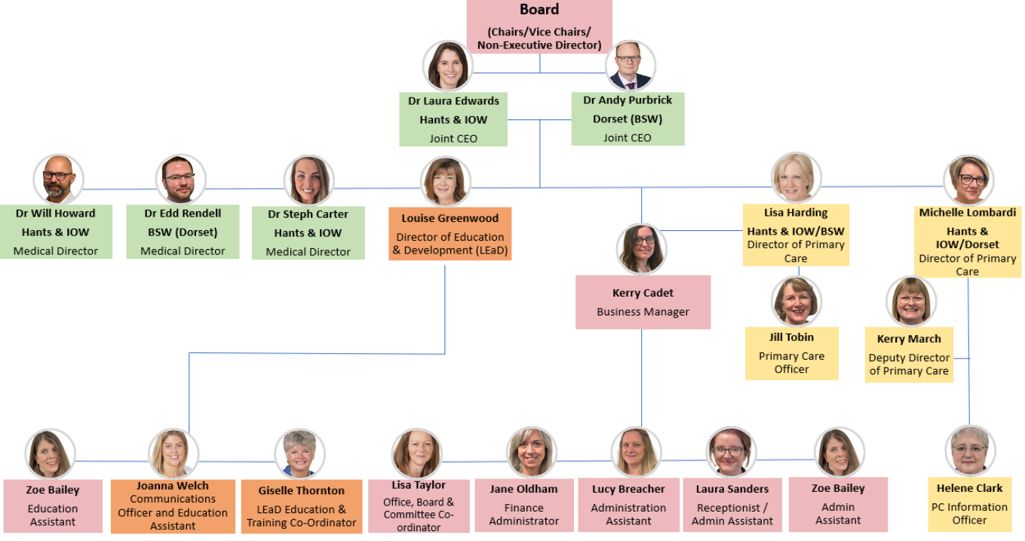
Wessex Local Medical Committees Ltd - The Office

