Slide 1
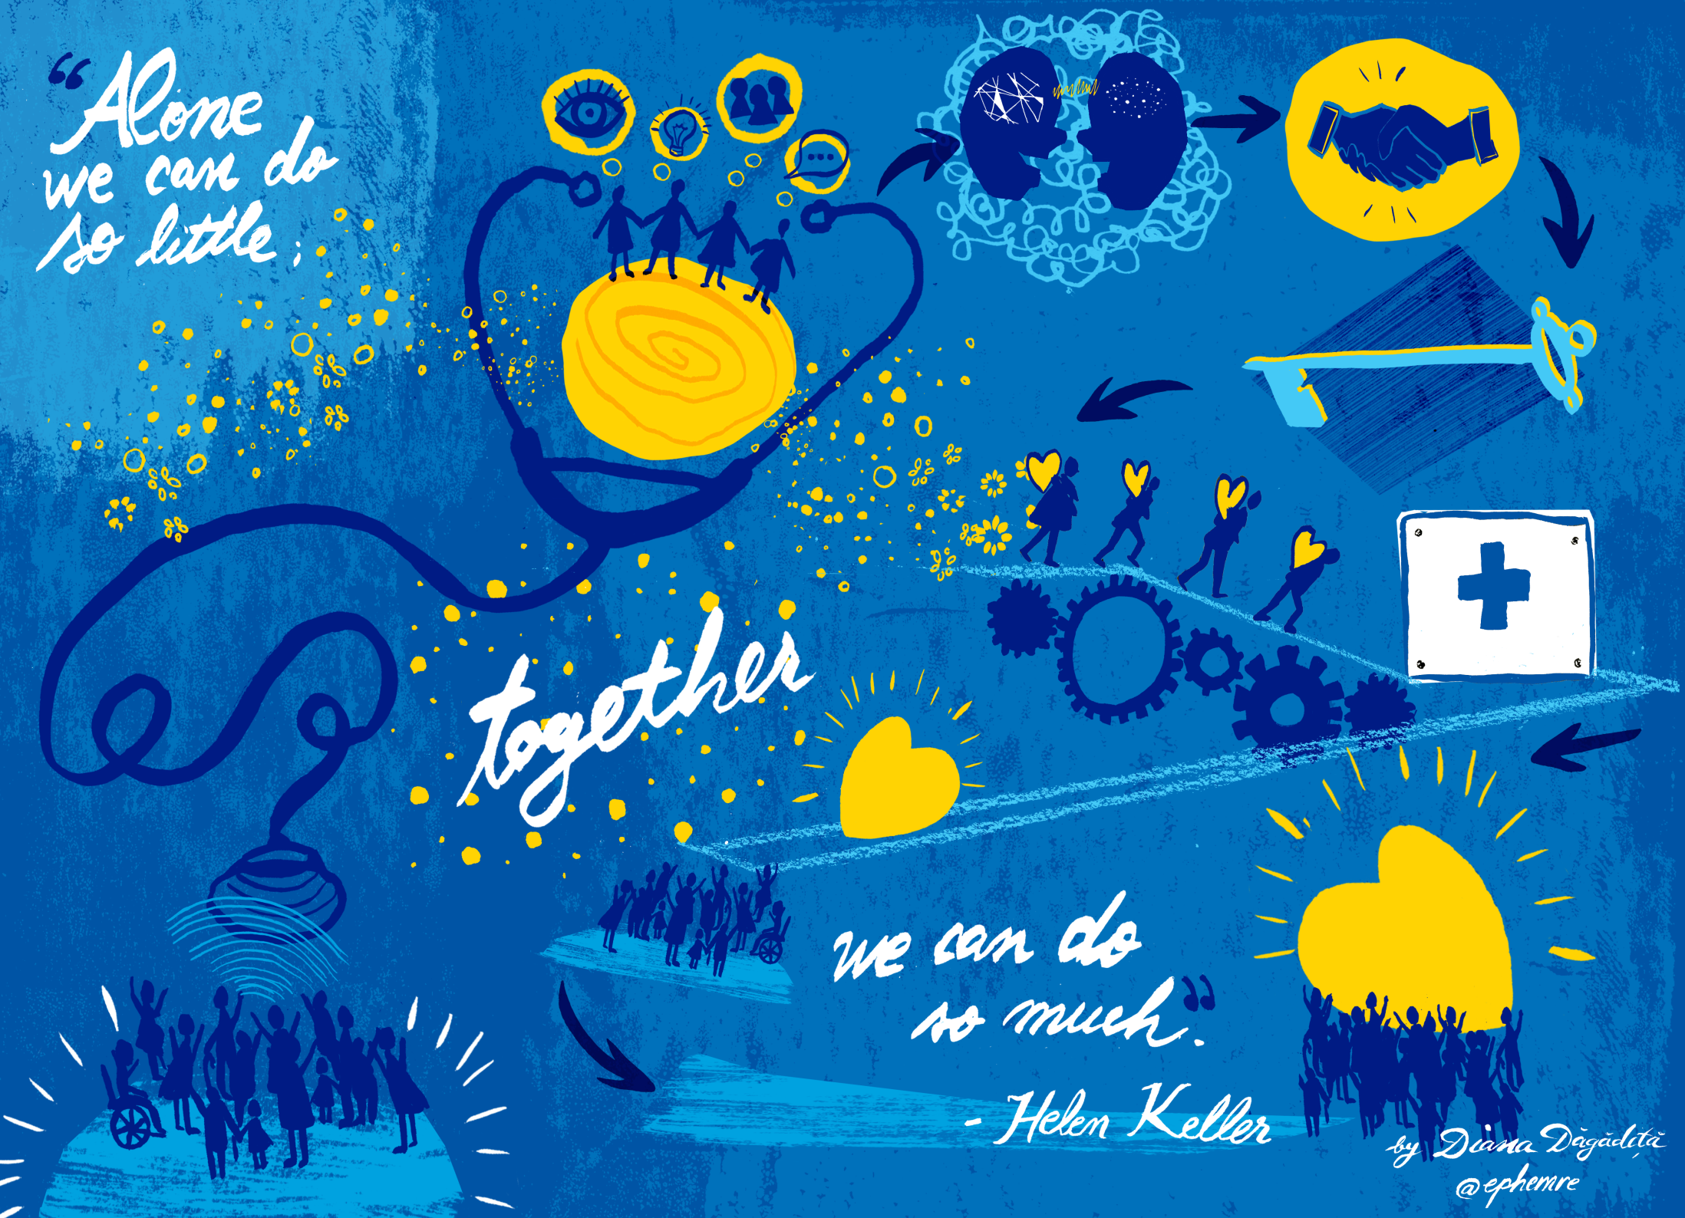
GP Consultant Exchange Dorchester 2018
Celebration of Learning and Next Steps

Slide 3
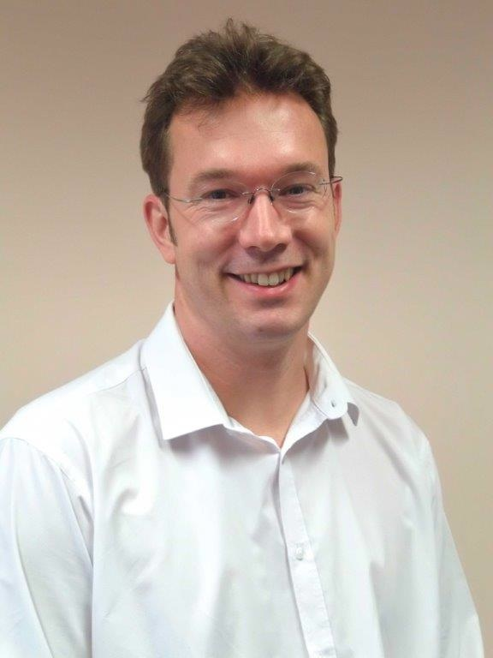
Introduction
“
As the NHS celebrates it 70th birthday, there is a growing recognition that the primary secondary care divide has become a gaping chasm that adversely affects patient care.
The NHS Five Year Forward View called for better integration of GP, community health, mental health and hospital services. Despite this, there is a lack of communication and understanding between primary and secondary care, which hinders collaborative working.
Clinicians increasingly tend to work in silos of their own specialist area. We are so overstretched that clinicians everywhere are trying to avoid more work and are competing for scarce resources. This leads to poor communication and fragmented care which is unsafe for patients.
“”
Dr Adam Fraser
GP Programme Director,
Bournemouth University
Consultant GP Liaison 2017 3

Slide 4
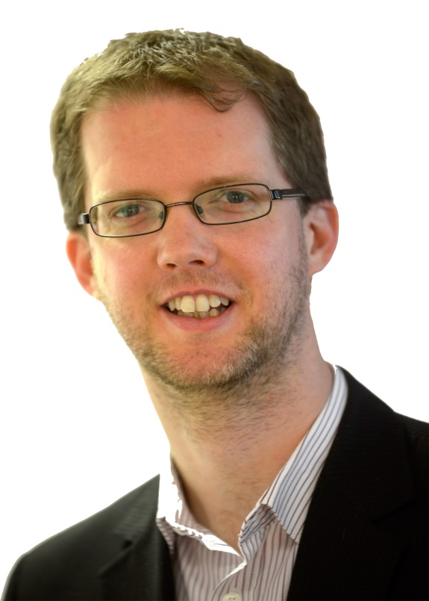
Other schemes
“
The consultant GP liaison scheme has provided a fantastic opportunity for us to break down the barriers that often exist between primary and secondary care.
I had the opportunity to take part in two exchanges and both really opened my eyes to how our hospital colleagues work and I believe the consultants involved agreed.
Perhaps the most surprising thing was how many of the same issues we are both dealing with. It was clear to me that knowing and understanding the specialists that I refer to has tremendous benefits for the patients we serve and, ultimately, can improve the care they receive.
“”
Dr Mark Kelsey,
Clinical Chair, Southampton City CCG
Consultant GP Liaison 2017 4

Slide 5
Other schemes
GP Consultant Exchange Scheme Video

Slide 6

What is this all about?
23 Consultants from DCH and 23 local GPs volunteered for the scheme, and were paired with each other.
Each pair spent half a day in each others workplace to experience the challenges they both faced Nov 2017 – Feb 2018.
Reflection templates were voluntarily returned and the information categorised into themes.
A feedback meeting to share learning took place in Feb 2018.
Consultant GP Liaison 2017 6

Slide 7

Feedback and Reflections

Slide 8

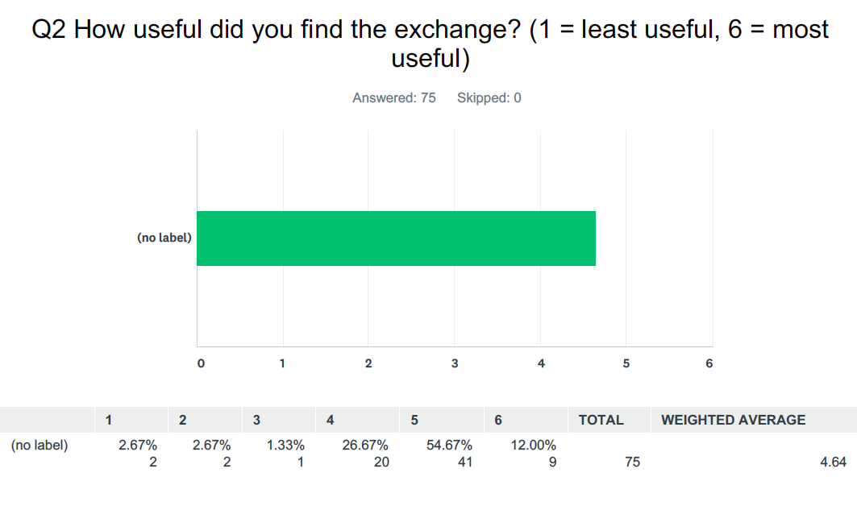
All schemes – How useful?

Slide 9
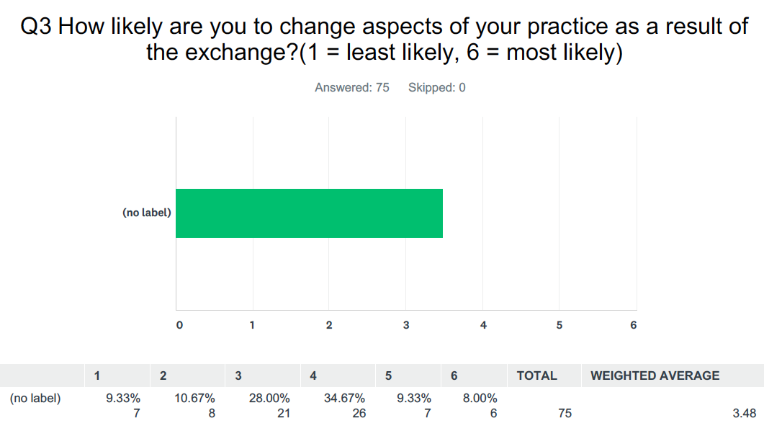
All schemes – Change Practice?

Slide 10
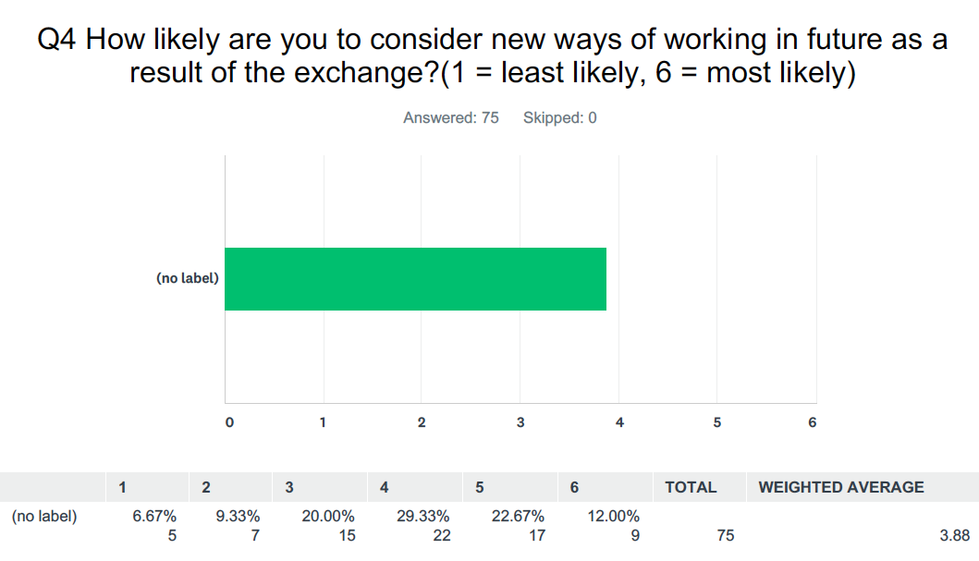
All schemes – Work Differently?

Slide 11
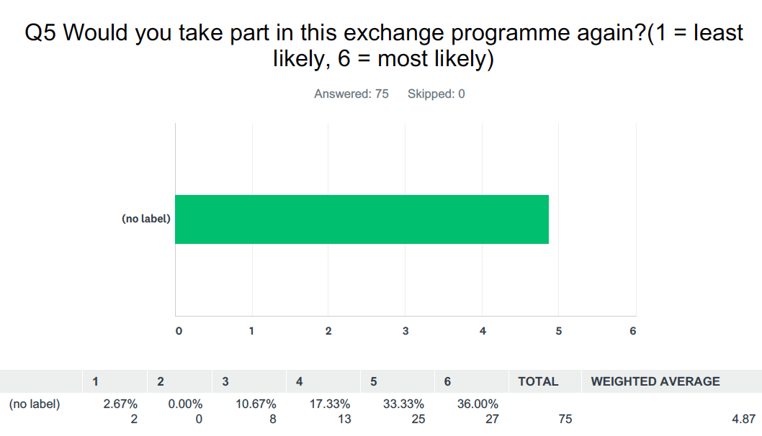
All schemes – Do it again?

Slide 12

Collaboration
“We are all dealing with a stretched service - we need to work together, not create barriers.”
“The luxury state of
having an MDT”
“The amazing camaraderie in a very difficult working environment that provides support for the staff”
“How difficult it is for consultants to contact GP’s I think the idea of a directory with everybody’s preferred method of contact is an excellent idea.”
“I was surprised by just how much team work there is in secondary care and that despite all of the pressures on the NHS these teams are still able to function at such a high level.

Slide 13

Compassion (and Jealousy!)
“The consultant was doing all the work on the ward round (except writing the notes). It was very much a consultant delivered service.”
“I think it is easy to not see the person on the other end of a letter as a true colleague but really the GP service does a very good job”
“I was impressed by the competence in dealing with a very wide range of patient types (from a tiny baby to an elderly gentleman) with great skill and in-depth assessment in a very short time frame.”
“The huge amount of resources that have gone into secondary care compared to primary care.”

Slide 14

Complexity
“The efficiency of GP to navigate through complex case and medications in short time.”
“There is a lot of risk taking in primary care and uncertainty, which takes great skill and confidence to manage. I am concerned that we do not talk about this enough, that the NHS does not support us enough (ie protect us from decisions that do not turn out well) and that there are several contradictory messages given by the NHS (refer less vs refer more; admit less vs make the service safer).”
“I joined a geriatrics consultant and saw the ongoing pressures on community care from the other side. I perhaps was a little surprised at the level of involvement the geris team still have after discharge that I wasn’t previously aware of.“
“Consultants face the same social challenges in their consultations.”

Slide 15

Efficiency
““Shocking facilities and support equipment, Office furniture old and broken, IT not working nor integrated, multiple systems not working together making it difficult to use easily for patient care, so not used?”
“Hospital records still
have the wrong GPs listed!”
“Unfortunately there was a lot of time spent searching
for folders strewn across the ward.”
“The use of acute Hospital beds for non acute patients, social cases are still blocking so much needed bed!”
“GPs will not get discharge summaries for 3 days at least therefore if a blood test needs to be done within a week you need to arrange it to be done yourself.”

Slide 16

Education
“I will understand referrals from GP better because I have refreshed my experience of how a GP practice is run.”
“I realised that consultants don’t have the luxury of having the patients whole medical record or drug history in front of them, hence the importance of giving as much details, in the referral letters we send.”
“The value of knowing our colleagues personally; realising we're in it together.”
“We had a helpful conversation about writing useful care plans for avoiding hospital admissions. I think we need time to plan these properly with patients and family and sharing what we have discussed either in primary care or secondary care is really important”
“A great insight after 23 yrs of hospital practise. Should be mandatory - including for our trainees.”

Slide 17
Summary
23 GP consultant pairs
Enables closer working between 1ry and 2ry care
Common themes from feedback:
  Collaboration
  Compassion (& Jealousy!)
  Complexity
  Efficiency
  Education

Slide 18
Next Steps?
Further exchanges
Visit different specialties on the same day
Exchange with a practice (instead of a GP)
GP and Consultant directories
New ways of working

Slide 19
Closing thoughts
Mark Twain wrote that travel broadens the mind. After walking in each other’s kingdom, we have gained a different perspective. Once we have this perspective, we find it easier to be more compassionate and resilient. We appreciate the challenges each other face in the NHS. Respect for each other and collaboration with each other come more naturally. Perhaps we will find that our kingdoms are not so different after all. Perhaps we will recognise that we all live in the same kingdom, and that we can share our wisdom for the benefit of all.

Slide 20
