Slide 1
Mpox Clade 1 – Primary care update
12th November 2024
Connie Timmins, Lead Nurse for Infection Prevention and Control
Jenny Bennett-Britton, Infection Prevention and Control Specialist Nurse.
NHS BSW ICB

Slide 2
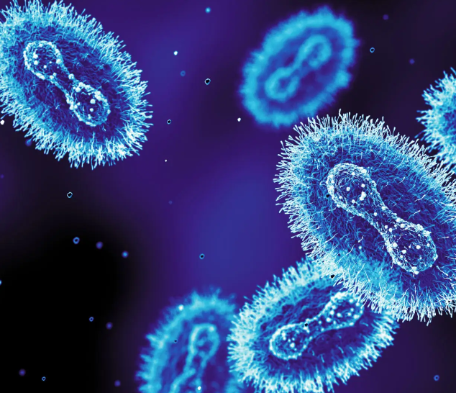
Aims and objectives
Background
Clinical features
Operational case definition
Public health considerations
Management guidance
PPE guidance
Environmental decontamination
Checklist

Slide 3
Background
Mpox is an infectious disease that is caused by infection with monkeypox virus (MPXV)
Was first discovered in 1958 when outbreaks of a pox-like disease occurred in monkeys kept for research
The first human case was recorded in 1970 in the Democratic Republic of the Congo (DRC), and since then the infection has been reported in a few African countries but predominantly DRC and Nigeria
Mpox transmission via main 3 routes; direct contact, indirect contact, respiratory droplet. Airbourne tranmission has not been ruled out.
Spread of mpox may also occur when a person comes into close contact with an infected animal (rodents are believed to be the primary animal reservoir for transmission to humans)
There are 2 major genetic groups (clades) of MPXV, clade I (formerly known as Central African or Congo basin clade) and clade II (formerly known as West African clade)

Slide 4
Background
Clade I - HCID (high consequence infectious disease)
Historically found in Central Africa (mostly DRC)
2023/2024 seen a geographical expansion in cases
Clade II – Non-HCID
Historically found in West Africa
Global outbreak in 2022
Predominantly found in sexual networks of gay, bisexual men who have sex with men
August 2024 WHO declared mpox clade I ‘Public health emergency of international concern’ (PHEIC)
In the DRC children have been disproportionality affected
To date, 4 cases of mpox clade 1 in the UK.
Previously reported case fatality rates of 10% in non-vaccinated individuals.
In January 2023 as declassified as an HCID
Emerging situation that is changing very rapidly.
Classifications may change.
Definition of HCID
Acute infectious disease Typically has a high case-fatality rate May not have effective prophylaxis or treatment Often difficult to recognise and detect rapidly | Ability to spread in the community and within healthcare settings Requires an enhanced individual, population and system response to ensure it is managed effectively, efficiently and safely

Slide 5
Clinical features - transmission
Mpox is a virus related to smallpox. It causes a rash illness that can range from mild and localised to severe and widespread.
The incubation period for mpox ranges from 6 to 13 days, although it can be as short as 5 days or as long as 21 days
The infectious period extends from the onset of symptoms until all lesions have healed and scabs have fallen off. It is important to note that scabs are considered potentially infectious.
Transmission occurs through direct contact with infectious skin or lesions, indirect contact with contaminated items (such as clothing and bed linen) and via respiratory droplets.
Mpox does not spread easily between people – requires close contact

Slide 6
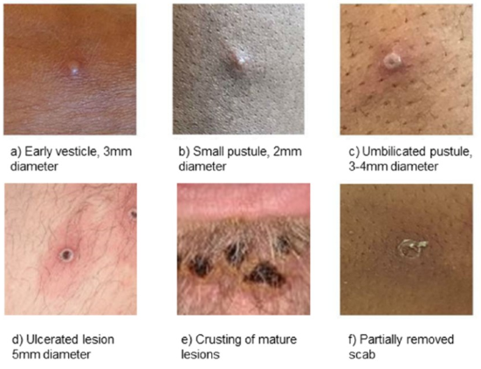
Clinical features – symptoms
The illness begins with:
Fever
Headache
Muscle aches
Backache
Swollen lymph nodes
Chills
Exhaustion
Joint pain
(not all people who have mpox experience all these symptoms)
Within 1-5 days of fever, rash develops. Often beginning on the face and then spreading to other parts of the body
An individual is contagious until all the scabs have fallen off and there is intact skins underneath. The scabs may also contain infectious virus material.

Slide 7
When to suspect mpox
Consider mpox where a case presents with:
1. a prodrome (fever, chills, headache, exhaustion, myalgia, arthralgia, backache, lymphadenopathy), and where there is known prior contact with a confirmed or suspected case of mpox in the 21 days before symptom onset
Or:
2. an mpox-compatible rash anywhere on the skin (face, limbs, extremities, torso), mucosae (including oral, genital, anal), or symptoms of proctitis, and at least one of the following in the 21 days before symptom onset:
  recent new sexual partner
  contact with known or suspected case of mpox
  a travel history to a country where mpox is currently common
  link to an infected animal or meat
If the rash is highly clinically suggestive of mpox, but you cannot identify a risk factor, discuss with local infection services whether to consider mpox testing alongside the more common differential diagnosis.
Consider common infections such as chickenpox or shingles, herpes simplex virus, and enterovirus in the differential diagnosis; these circulate widely and are more common than mpox; exclude as appropriate.

Slide 8
When to consider clade 1 mpox: HCID operational case definition
When to suspect clade 1 mpox
In a person with clinically suspected mpox, they should be managed as HCID if they meet one or more of the following criteria:
has a travel history to specified countries where there may be a risk of clade I exposure in the 21 days before symptom onset
Countries where there may be a risk of Clade I exposure
Democratic Republic of the Congo - higher risk
Burundi - higher risk
Uganda - higher risk
Central African Republic - lower risk
Kenya - lower risk
Republic of the Congo - lower risk
Rwanda - lower risk
Gabon- lower risk
Cameroon - lower risk
Sudan - lower risk
South Sudan - lower risk
Countries with a risk of Clade I mpox exposure (based on border with DRC: Angola, South Sudan, Tanzania, Zambia
has an epidemiological link to a confirmed or suspected case of clade I mpox in the 21 days before symptom onset
has a relevant zoonotic link, including contact with a wild or captive mammal that is an African native species (this includes contact with derived products, for example, game meat)
Travel History and time period is key
Given the evolving situation and rapid spread of Clade I in the African Region, ensure that your systems are regularly updated by checking the gov.uk UKHSA mpox webpages for any changes in the list of countries at risk or with confirmed cases.

Slide 9
Notification and public health considerations
If you see a patient who meets the case definition for possible clade I mpox, call Imported Fever Service ASAP 24/7 on 0844 788 8990
IFS will advise on likelihood, differentials and testing. Currently approximately 24hr turnaround on testing
Report all suspected cases urgently via phone to local UKHSA Health Protection Team (HPT)
HPT can support with risk assessment.
Also liaise with your local Infection Prevention Specialist
Where admission is planned, contact the local hospital regarding appropriate isolation before patient arrives
At present, public health action only starts when a positive mpox PCR is received.

Slide 10
Risk assessment – hierarchy of controls
Elimination
Substitution
Engineering
Administration
PPE
Where possible, remove the hazard
Consider virtual rather than in person reviews
Implement measures to control, mitigate, or isolate the hazard
Establish and follow safe systems of work
Ensure the availability and adequacy of PPE, including respiratory protective equipment, to protect healthcare staff

Slide 11
Current management guidance
Triage
Source control
Patient placement
Any patients presenting with fever and rash may be infectious (eg, measles or chickenpox).
Whenever possible, conduct telephone triage to assess symptoms and the risk of mpox before face-to-face contact.
On arrival, patients must be promptly assessed for infection risk.
This should be done in a designated/isolated area.
All clinically suspected and confirmed mpox cases should be provided with a fluid-resistant surgical mask (FRSM) upon arrival in healthcare settings.
The mask should remain in place throughout the consultation or treatment unless removed for clinical reasons.
The use of FRSMs must never compromise clinical care, such as during oxygen therapy or in cases where the mask causes significant distress (eg, paediatric patient).
Covering mpox lesions with clothing or dressings may reduce the risk of transmission in shared or public spaces.
Isolate/socially distance patient in designated space.
Virtual assessment should take place (for example, by phone).
Staff should not physically assess the patient without personal protective equipment.
Contact the local infection service for advice.

Slide 12
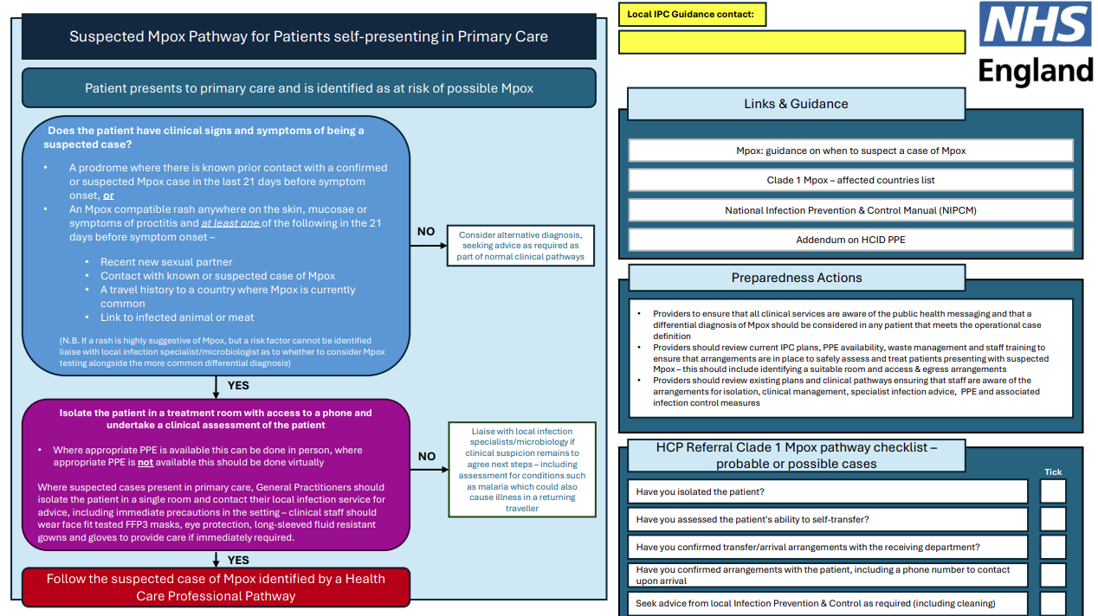
NHS England Action Cards for Primary Care
Link to Action cards

Slide 13
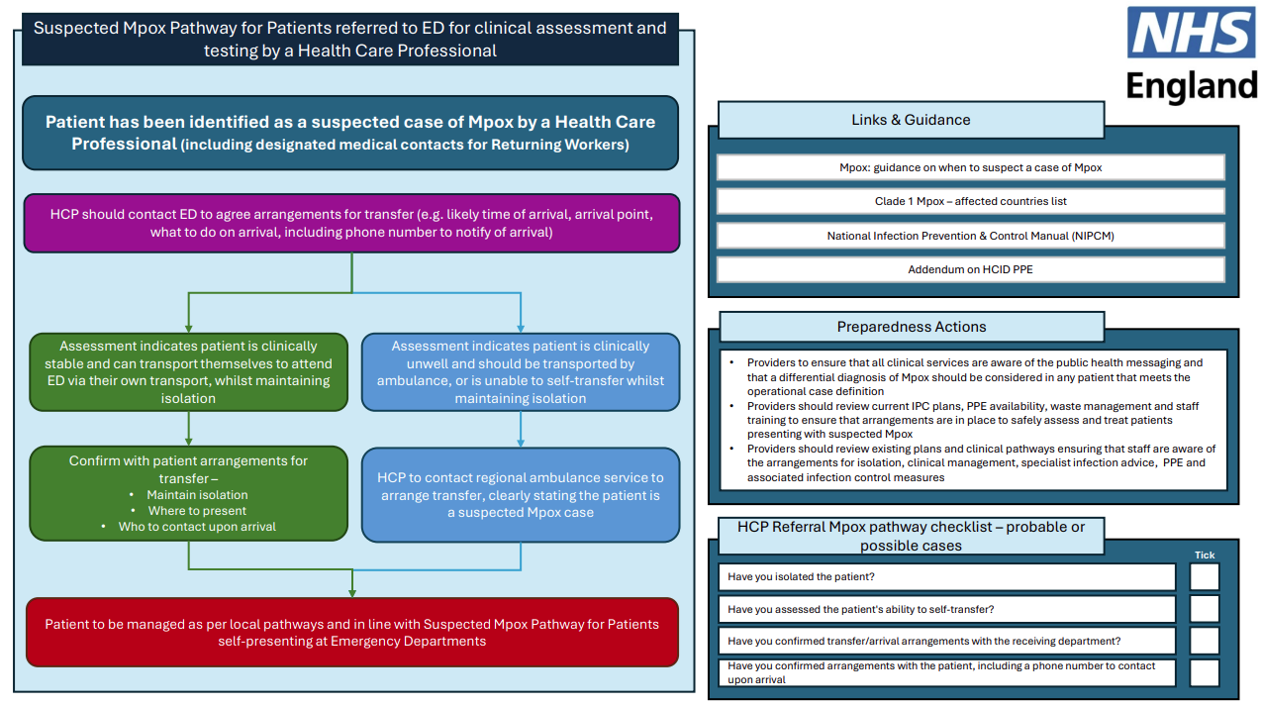
NHS England Action Cards for Primary Care

Slide 14
Remember….
If you see a patient who meets the case definition for possible clade I mpox, call Imported Fever Service ASAP 24/7 on 0844 788 8990
AND
Report all suspected cases urgently via phone to local UKHSA Health Protection Team (HPT)
Telephone: 0300 303 8162 (option 1, then option 1)
Out of hours for health professionals requesting urgent advice: 0300 303 8162 (option 1)

Slide 15
PPE - current guidance
As per Health and Safety at Work Act 1974: All healthcare organisations are responsible for ensuring they have sufficient supplies of the required PPE, and that their staff are trained and competent in its proper use
The government scheme for free PPE provision to health and social care sectors in response to Covid-19 has ended.
Primary care providers, like all NHS providers, are now responsible for sourcing and purchasing their own PPE, including FFP3 respirator masks and fit testing, to maintain safe working conditions for infection prevention and control (IPC).
PPE requirements for clinically suspected or confirmed mpox cases are determined by risk assessment that includes high consequence infectious disease (HCID) classification, patient’s presenting symptoms, and type and duration of patient contact and care.

Slide 16
PPE for clinically suspected and confirmed mpox clade II
Any individual presenting with unexplained rash/symptoms suggesting clinically suspected mpox
Single pair of disposable gloves
Disposable, fluid-resistant apron (or disposable, long-sleeved, fluid-resistant gown where extensive manual handling or unavoidable skin-to-skin contact is anticipated)
FRSM (type IIR)
Eye/face protection (if there is a risk of spraying/splashing)
If the individual has respiratory symptoms or extensive lesions/deteriorating condition a higher level of PPE is required.
Single pair of disposable gloves
Disposable, long-sleeved, fluid-resistant gown
Eye/face protection (full face visor)
FFP3 respirator (fit-tested and fit-checked)
Guidance for safe donning and doffing of airborne PPE is available in appendix 6 of the NIPCM.

Slide 17
PPE for clinically suspected and confirmed mpox clade I in primary care
Airborne PPE
Single pair of disposable gloves
Disposable, long-sleeved, fluid-resistant gown
Eye/face protection (full face visor)
FFP3 respirator (fit-tested and fit-checked)
As per:
‘Infection prevention and control measures for clinically suspected and confirmed cases of mpox in healthcare settings’
and
Appendix 5b of the National Infection Prevention and Control Manual
To note:
The requirements for suitable and adequate PPE in the ambulance service may differ due to the settings and conditions in which they operate.
i.e. Paramedics may be wearing different PPE to primary care for transfer.

Slide 18
Environmental decontamination
Equipment
Dedicate patient care equipment to individual patients and minimise the amount of equipment and stock in the room.
Environment
Clean and disinfect waiting areas, facilities (such as toilets), treatment or assessment areas useing either:
Waste
Waste and samples from individuals suspected or confirmed to have mpox should be treated as healthcare (clinical) category B waste
This waste can be disposed of in an orange bag for alternative treatment and does not require incineration. It is classified under UN 3291 as clinical waste.
Decontaminate reusable non-invasive care equipment in the room before removal using either:
a combined detergent/disinfectant solution with a concentration of 1,000 ppm av.cl
or
a general-purpose neutral detergent in warm water followed by a disinfectant solution of 1,000ppm av.cl (or an alternative locally agreed cleaning product)
a combined detergent/ disinfectant solution with a concentration of 1,000 parts per million (ppm) available chlorine (av.cl)
or
a general-purpose neutral detergent in warm water followed by a disinfectant solution of 1,000ppm av.cl. (or an alternative locally agreed cleaning product)
Clean from highest to lowest points and from the least to most contaminated areas, ensuring all equipment and surfaces (including floors) are decontaminated.
If the waste contains chemical or pharmaceutical contaminants, it must be placed in a yellow container (or purple if cytotoxic or cytostatic), and either incinerated or sent to a permitted site for disposal as per national regulation.
Staff responsible for decontamination of healthcare environments where clinically suspected or confirmed mpox cases are managed must be properly trained in the correct use of all products and the necessary personal protective equipment

Slide 19
Checklist to consider
Staff aware of operational case definition
Identified area to isolate the patient
Staff have access to/are trained to use correct PPE
Staff are aware of who to contact from IFS/ HPT
Assess patient’s ability to self-transfer to hospital if needed.
Clear and advance communication with receiving department
Environmental decontamination and waste management

Slide 20
Current published guidance
NHS England » NHS response to outbreak of Clade I mpox in Eastern and Central Africa
Infection prevention and control measures for clinically suspected and confirmed cases of mpox in healthcare settings
Mpox patient pathway action cards (england.nhs.uk) last updated 25.10.24
Rare and Imported Pathogens Laboratory (RIPL) Specimen referral guidelines and service user manual
Appendix 6: Donning and doffing respiratory personal protective equipment (PPE)

Slide 21
Any questions?

